Slide 1
MOGLINO SEZ | PSKOV 2020
UNTAPPED RUSSIAN MARKET POTENTIAL WITH
DIRECT ACCESS TO THE EU
MOGLINO | SPECIAL ECONOMIC ZONE

Slide 2
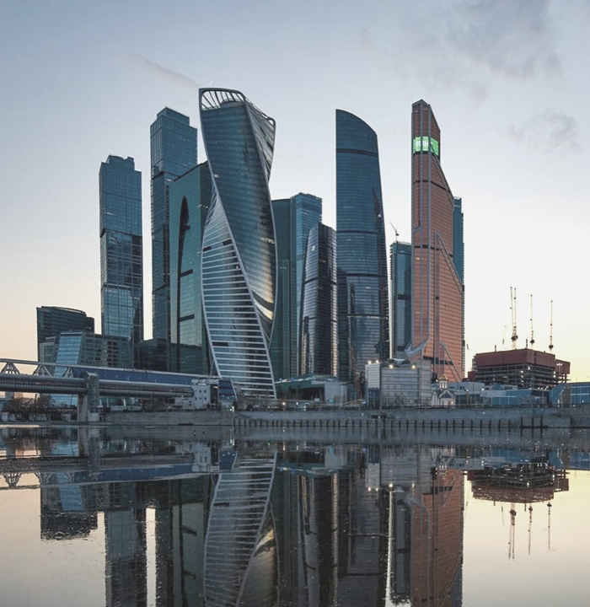
Russia's economic relevance
Area: 17 mln. sq. km.
Population: 146,8 mln (15 cities above 1 mln residents)
Nominal GDP: 1577 bln USD
GDP per capita: 10.950 €
Ease of doing business rank: 31
(positive trend)
More than 190 nationalities
speaking 37 languages
Russia is a Federation with 85
Regions across 11 time zones
Three levels of legislation and
State Power (Federal, Regional, Municipal)
MOGLINO SEZ | OCTOBER 2020

Slide 3
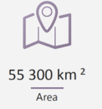
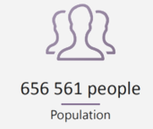
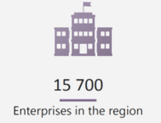
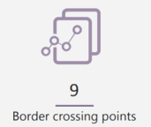
PSKOV OBLAST
Russia´s Western Door
MOGLINO SEZ | OCTOBER 2020

Slide 4
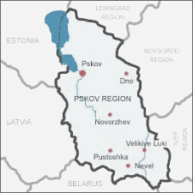
Pskov Oblast
Connectivity
30% of trade between EU and Russia runs through Pskov
Road and railway network connect Pskov with Moscow, St. Petersburg, Riga, Tallinn, Lvov, Odessa,
Murmansk and Kaliningrad ports.
International airport
River port
Leading telecommunications network in Russia
MOGLINO SEZ | OCTOBER 2020

Slide 5
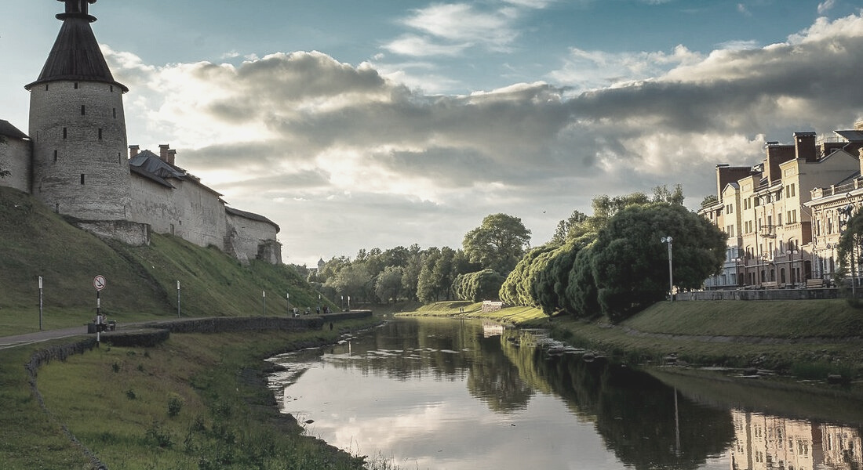
340 011
EMPLOYABLE POPULATION
2316
GRADUATES ANNUALLY
11
HIGHER EDUCATION
INSTITUTIONS
Pskov Oblast
Human Capital
15
VOCATIONAL SCHOOLS

Slide 6
R&D CENTER
Strategic partnership with Pskov State University
2,500 graduates per year
UNIVERSITY PROGRAMS
Power & Machinery Production • Automotive & Transportation • Food Production Technology • Architecture & Construction • Agriculture & Fish Breeding • Economy & Management • Information Technology • Services Industry
TECHNICAL COLLEGE PROGRAMS
• Commodity research • Woodworking Technologies• Auto mechanics• Finishing work • Welding• Electrical installation • Architecture• Building management • Gas supply management • Radio apparatus engineering • Tourism
Nurturing talent

Slide 7
Pskov University collaboration
Biochemistry
Center of Competence
MOGLINO SEZ | OCTOBER 2020
Dr. Taras K. Antal,
Ph.D. in Biophysics and Hydrobiology, vice-rector for science in Pskov State University

Slide 8
Moglino SEZ
Gateway between Russia & EU
MOGLINO SEZ | OCTOBER 2020

Slide 9
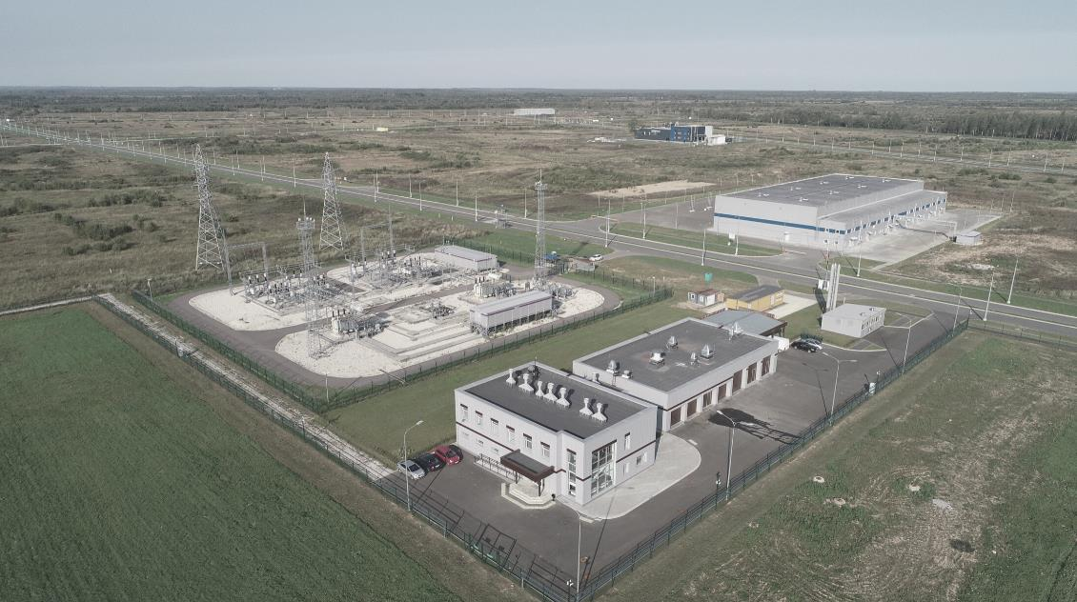
Moglino SEZ
Manufacturing
R&D Biochemical
Logistics
MOGLINO SEZ | OCTOBER 2020

Slide 10
Investment Opportunities
AGRICULTURAL & FOOD PROCESSING
CHEMICAL/BIOCHEMICAL & PHARMACEUTICALS
AUTOMOTIVE COMPONENTS
TRANSPORT EQUIPMENT INDUSTRY
MACHINERY & EQUIPMENT MAUFACTURING
CONSTRUCTION MATERIALS
ELECTICAL & CONSUMER
LOGISTICS

Slide 11
Investment Opportunities
AGRICULTURAL & FOOD PROCESSING
CHEMICAL/BIOCHEMICAL & PHARMACEUTICALS
AUTOMOTIVE COMPONENTS
TRANSPORT EQUIPMENT INDUSTRY
MACHINERY & EQUIPMENT MAUFACTURING
CONSTRUCTION MATERIALS
ELECTICAL & CONSUMER
LOGISTICS

Slide 12
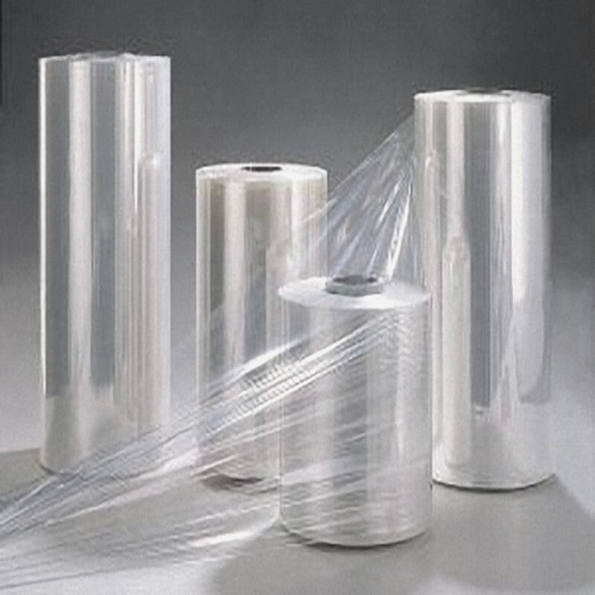
Investment Opportunities
AGRICULTURAL & FOOD PROCESSING
CHEMICAL/BIOCHEMICAL & PHARMACEUTICALS
AUTOMOTIVE COMPONENTS
TRANSPORT EQUIPMENT INDUSTRY
MACHINERY & EQUIPMENT MAUFACTURING
CONSTRUCTION MATERIALS
ELECTICAL & CONSUMER
LOGISTICS

Slide 13
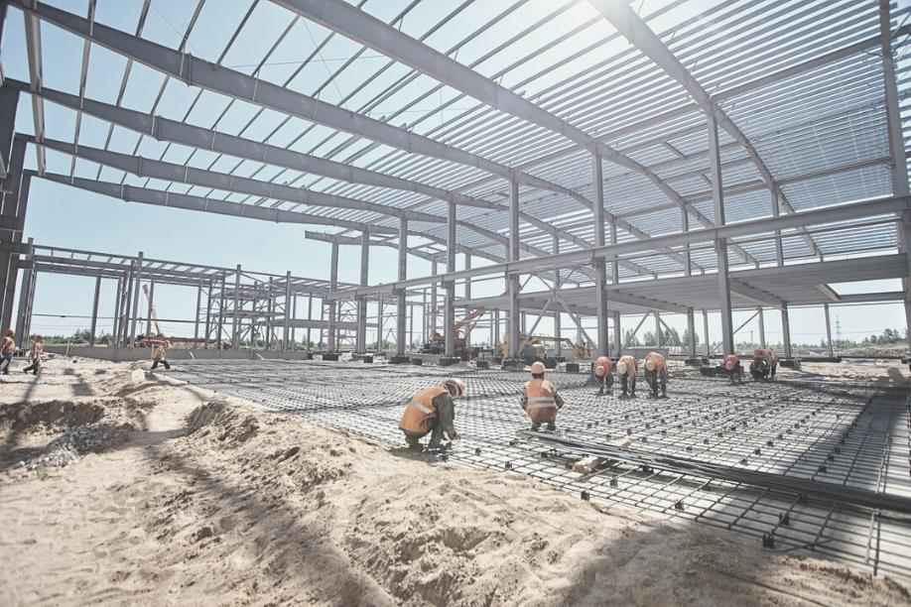
Investment Opportunities
AGRICULTURAL & FOOD PROCESSING
CHEMICAL/BIOCHEMICAL & PHARMACEUTICALS
AUTOMOTIVE COMPONENTS
TRANSPORT EQUIPMENT INDUSTRY
MACHINERY & EQUIPMENT MAUFACTURING
CONSTRUCTION MATERIALS
ELECTICAL & CONSUMER
LOGISTICS

Slide 14
Investment Opportunities
AGRICULTURAL & FOOD PROCESSING
CHEMICAL/BIOCHEMICAL & PHARMACEUTICALS
AUTOMOTIVE COMPONENTS
TRANSPORT EQUIPMENT INDUSTRY
MACHINERY & EQUIPMENT MAUFACTURING
CONSTRUCTION MATERIALS
ELECTICAL & CONSUMER
LOGISTICS

Slide 15
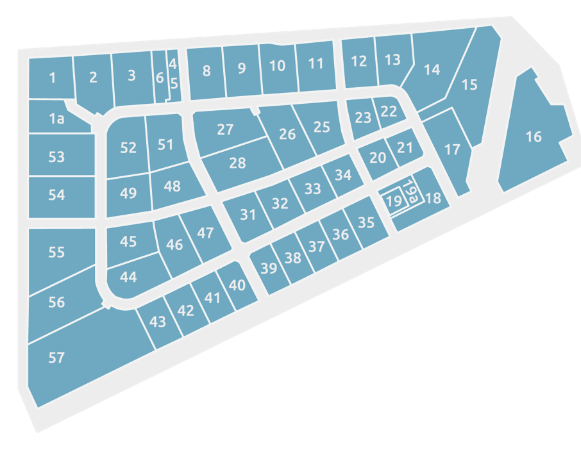
Free land plots
Phase 1 complete
From $4,2 year/ha
land plot lease (administrative fee only)
FRom $95 /ha
land plot purchase (administrative fee only)
Minimum CAPEX 120 million RUB
“One Stop-Shop” service for investors
Full project support for residents
Free connection to the hub of utilities and resources

Slide 16
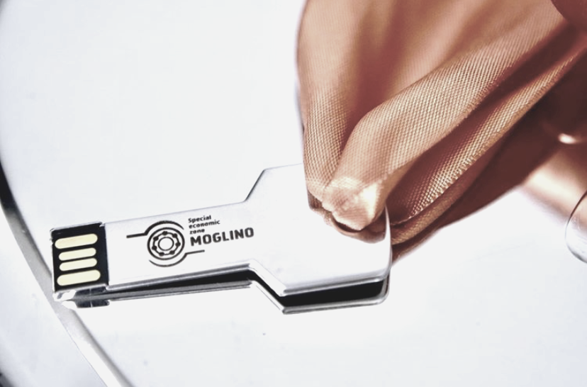
0% PROPERTY TAX
Exempt from property tax for the period of 10 years after the property registration.
0% LAND TAX
Exempt from land tax for the period of 5 years.
0% VEHICLE TAX
Exempt from vehicle tax for the period of 10 years after the vehicle registration.
VAT INCENTIVES
Startup capital to launch design and manufacturing is only 600 thousand euro (in rubles) within first 3 years
Unlock benefits

Slide 17
Turnkey solutions
FACTORY BUILT-TO-LEASE
READY-TOUSE INFRASTRUCTURE
LOW COST OF LAND LEASE AND PURCHASE
Total production area 3,740 m2
Total office area 1,260 m2
Design customization
Utilities provided
Gas supply 122 th.n.m3/year
Power supply 120 MVА
Water supply 4900 m3/day
Wastewater removal 3,500 m3/day
Transport infrastructure 6,4 кm
Land lease price starts at 310 rub per ha per year.
After plant construction is completed, a resident can purchase the land lot from 6,902 rub per ha.

Slide 18
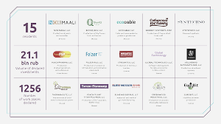
Moglino SEZ's Residents
MOGLINO SEZ | OCTOBER 2020

Slide 19
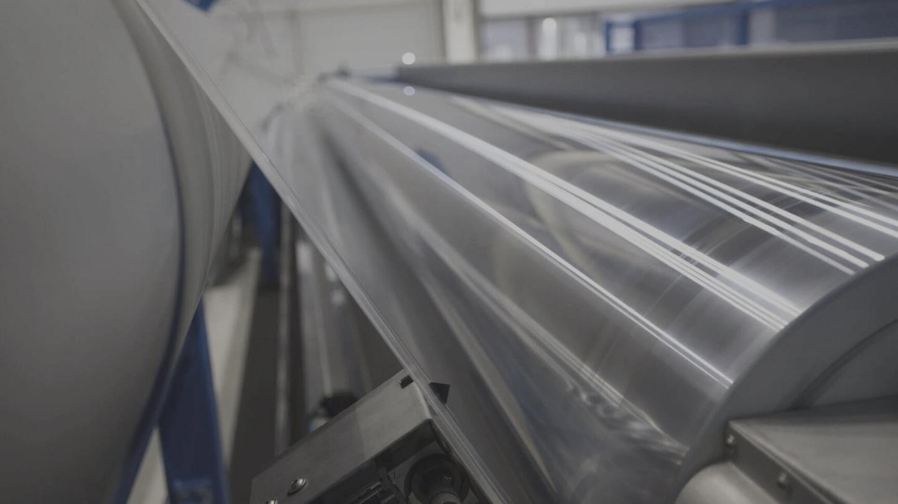
Titan-Polymer
Pskov plant "Titan-Polymer", Moglino's anchor resident, has successfully set up an integrated iimport-substituting and export-oriented production facility of polyester (PET granules) and biaxially oriented films for food, medical and other industries. The project is being supported by the Ministry of Industry and Trade of the Russian Federation and state financial institutions.
Total investment 15 bln. Rub (EUR 167 million)
500 direct / 2,000 indirect jobs created
. https://titan-polymer.ru/
MOGLINO SEZ | OCTOBER 2020

Slide 20
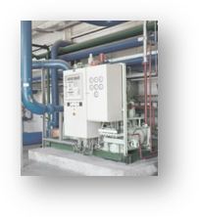
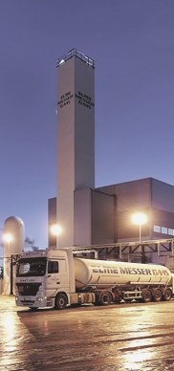
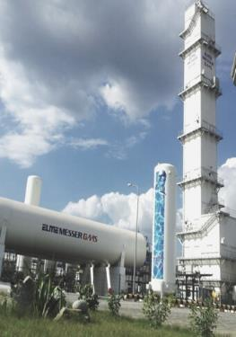
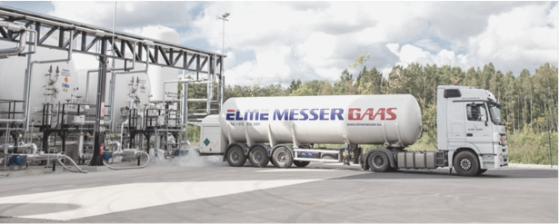
Elme Messer Gaas AS
MOGLINO SEZ | OCTOBER 2020
Leading gas company in the Baltic region, a joint venture of BLRT Grupp AS (Estonia) and Messer Group GmbH (Germany). Producer of industrial liquefied gases (nitrogen, argon, oxygen).
Total investment 1,9 billion RUB (EUR 21 million)
Production starts in 2021
https://elmemesser.ee/
Click here information about the project
.

Slide 21
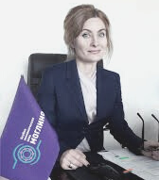
Our team is ready to support
EKATERINA PYKHTINA
NATALIA YUSHKO
MS XXX
Head of Investor Relations
CEO
Investor Support

Slide 22
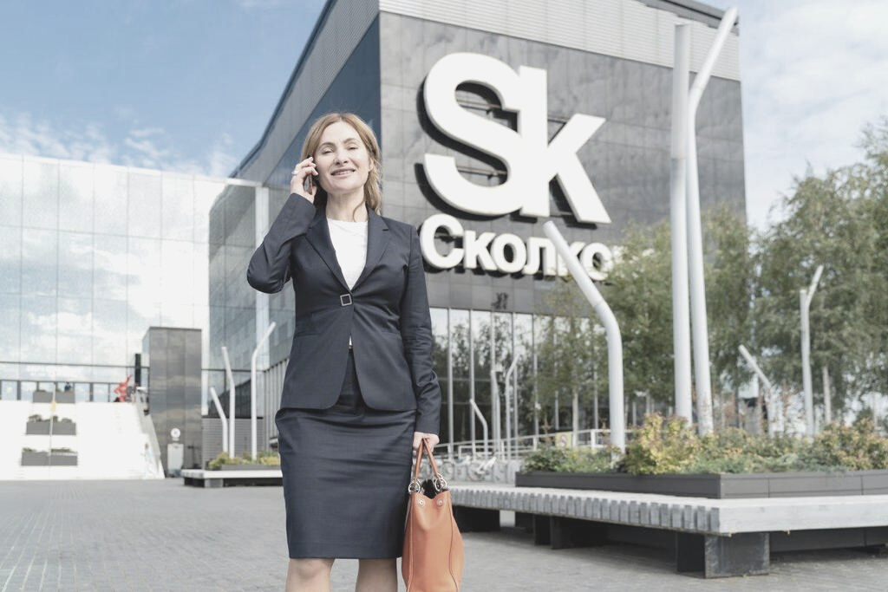
FOR INQUIRIES
Contact us
SITE OFFICE
180502, Pskov region, Pskov district,
Moglino village , SEZ PPT Moglino, h.18
Russia
+7 8112 29-33-33
info@moglinosez.ru
moglino.com
MOGLINO SEZ | OCTOBER 2020

