Slide 1
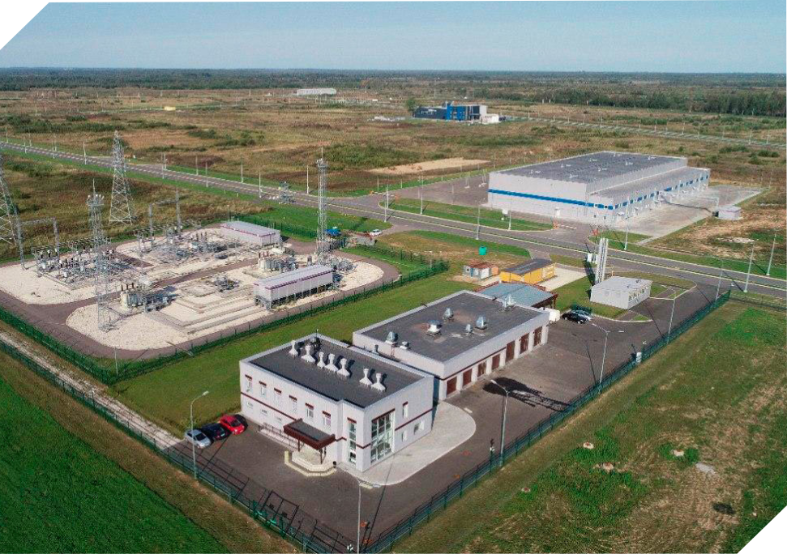
SPECIAL ECONOMIC
OPPORTUNITIES
AT THE BORDER ON THE
EUROPEAN UNION
SPECIAL ECONOMIC
OPPORTUNITIES
AT THE BORDER ON THE
EUROPEAN UNION
2020

Slide 2
Moglino Special economic zone of industrial production type
was established in accordance with the decree of the Government of the Russian Federation dated July 19, 2012 No. 729 «On the creation of a special economic zone of industrial and production type on the territory of the Pskov district of the Pskov region»
MAIN ACTIVITY AREAS OF MOGLINO SEZ
Construction of new facilities on the territory of a special economic zone
Management of facilities that are already in operation
Attracting new investors
Consulting and supervising within ‘one stop shop» service
Moglino SEZ is integrated with the common values and philosophy of the project “Russia. Special economic zones”

Slide 3
MOGLINO SEZ FACTORS OF INVESTMENT ATTRACTIVENESS
MISSION OF
MOGLINO SEZ
Support at the
regional and federal
levels
Low cost of land lease and land purchase
Ensuring the local society keeps on the economic transition towards the innovative development model
Tax and customs benefits
Infrastructure
readiness 100%
We create world-class industrial infrastructure
Strategic partnerships with financial institutions
SEZ provides a One stop-shop service – consulting services to accompany investors

Slide 4
PSKOV REGION
11
Higher education
institutions
15
Vocational schools
2316
graduates annually
2316
graduates annually
Tallinn
St. Petersburg
Riga
Pskov
55 300 km²
Total area of Pskov region
Minsk
Moscow
629 651 people
population
340 011 people
Employable population

Slide 5
ABOUT MOGLINO SEZ
Moglino SEZ total area
ha for industrial development
300 ha
122
th.n.m³/year
Gas supply
In-site gas distribution network - 4.6 km
Average tariff - $81 th/m³
SEZ duration
in 2012 the territory was granted SEZ status
49 years
120 MVA
Electricity
In-site power substation - PS 110/10 kW
Average tariff - $0,044 kWt/h
Infrastructure completeness
100 %
4900
m³/day
Water
5 artesian wells
Average tariff - $0,5 /m³
15 residents
Tenants are at different stages of project
implementation
15
projects
3500
m³/day
Wastewater removal
SPS — 2 pcs.
Average tariff - $0,3 /m3
Standard designed factory area
ready industrial and production facility
5000 m²
6,4 km
Transport infrastructure
Outbound and in-site automobile roads

Slide 6
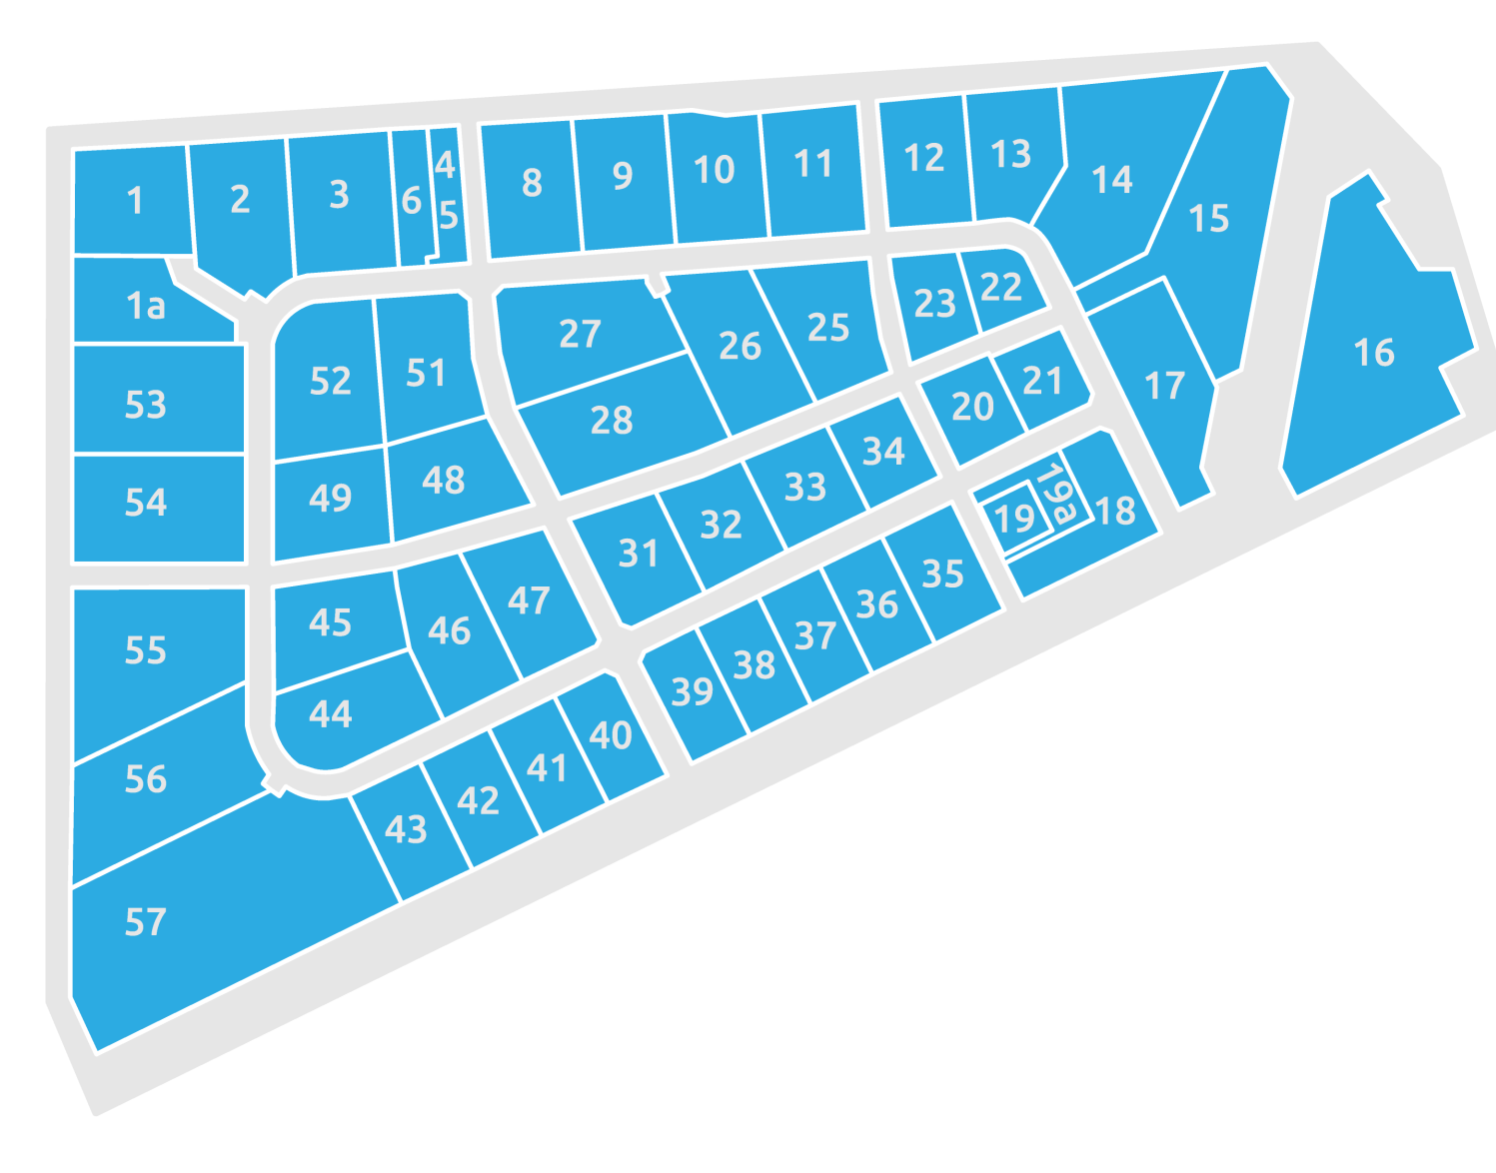
BENEFITS FOR RESIDENTS
30%
Up to investment savings
Moglino SEZ Land plots for localization
“One Stop-Shop” service for investors
Integrated business process support
Counseling on existing resident support measures
Development of business plans
Market analyses
Legal issues on entity establishment
Organization of events
Full project support for residents
Legal issues of land lease and purchase
Engineering and construction supervising tailored service
Consultation during project design
Construction supervision
Representation and advocacy for the institutional and business environment
from $4,2 year/ha
land plot lease
Provision of energy resources
from $95 /ha
land plot purchase
Free technological connection
to utility networks

Slide 7
TAX AND CUSTOMS EXSEMPTIONS
Upon obtaining of the resident status, the company gets the opportunity to use all the benefits and preferences that can significantly save the investor’s time and money, increasing the economic efficiency of the project.
*
*
*
**
PROFIT TAX
LAND TAX
PROPERTY TAX
TRANSPORT TAX
DUTIES FOR DEPARTURE FROM RUSSIA AND THE COUNTRIES OF THE CUSTOMS UNION ***
DUTIES FOR IMPORTING TO RUSSIA AND THE COUNTRIES OF THE CUSTOMS UNION***
Discount depreciation factor for property (2)
* The profit tax benefit becomes effective from the first profit. Federal Income Tax is 2%
** In addition to light, water and air vehicles with an engine power of over 250 horsepower
***The Customs Union includes the Russian Federation, Kazakhstan, Belarus, Armenia, Kyrgyzstan

Slide 8
8

Slide 9
TO BECOME A RESIDENT
SUPERVISORY BOARD
Preparation of an introductory project presentation.
III-V Level of production hazards
Legal entity on the territory of Pskov district of the Pskov region
PROJECT PREPARATION
Total investments per project not less than
120 million of RUB(approx. $1 600 k )
excludes intangible assets
40 million of RUB (approx. $548 k)
within 3 years
Preparation of the company’s business plan in the form of the Ministry of Economic Development.
EXPERT COUNCIL
List of documents
Investor’s application form,
Business plan,
Copies of documents of incorporation,
Copy of certificate of state registration of legal person,
Copy of the tax registration certificate.
Signing of a tripartite agreement with Region Government represented by Governor & Moglino SEZ Management Company

Slide 10
MOGLINO SEZ DEVELOPMENT STRATEGY
Scaling the value
chain
Center for the Development
of Innovations and
Competencies
Cluster concept of Moglino SEZ
Raw materials base of the Pskov region
Regional specialization (biochemical direction)
Industrial
Technopark Moglino
Regional
logistics hub
Intermodal «dry port»
High-speed container transportation
R&D, technology commercialization,
venture ecosystem

Slide 11
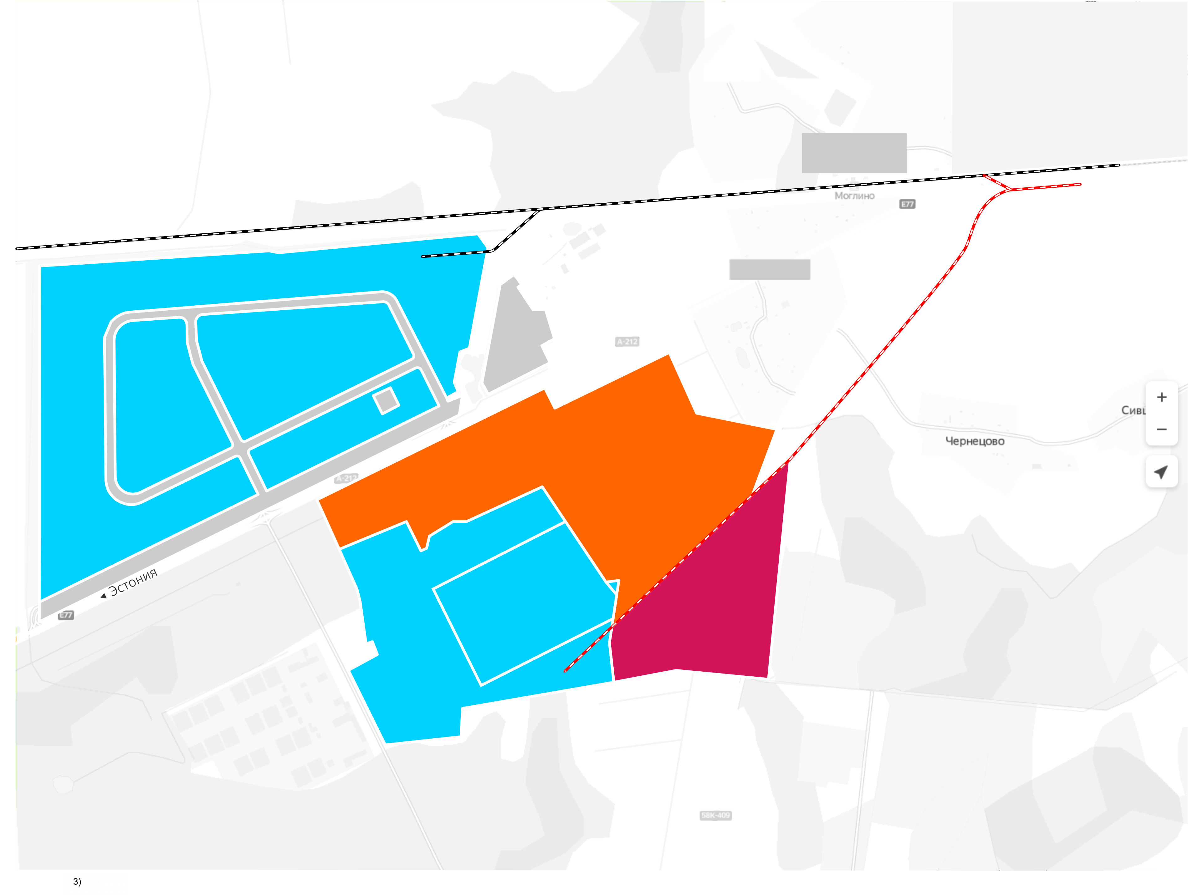
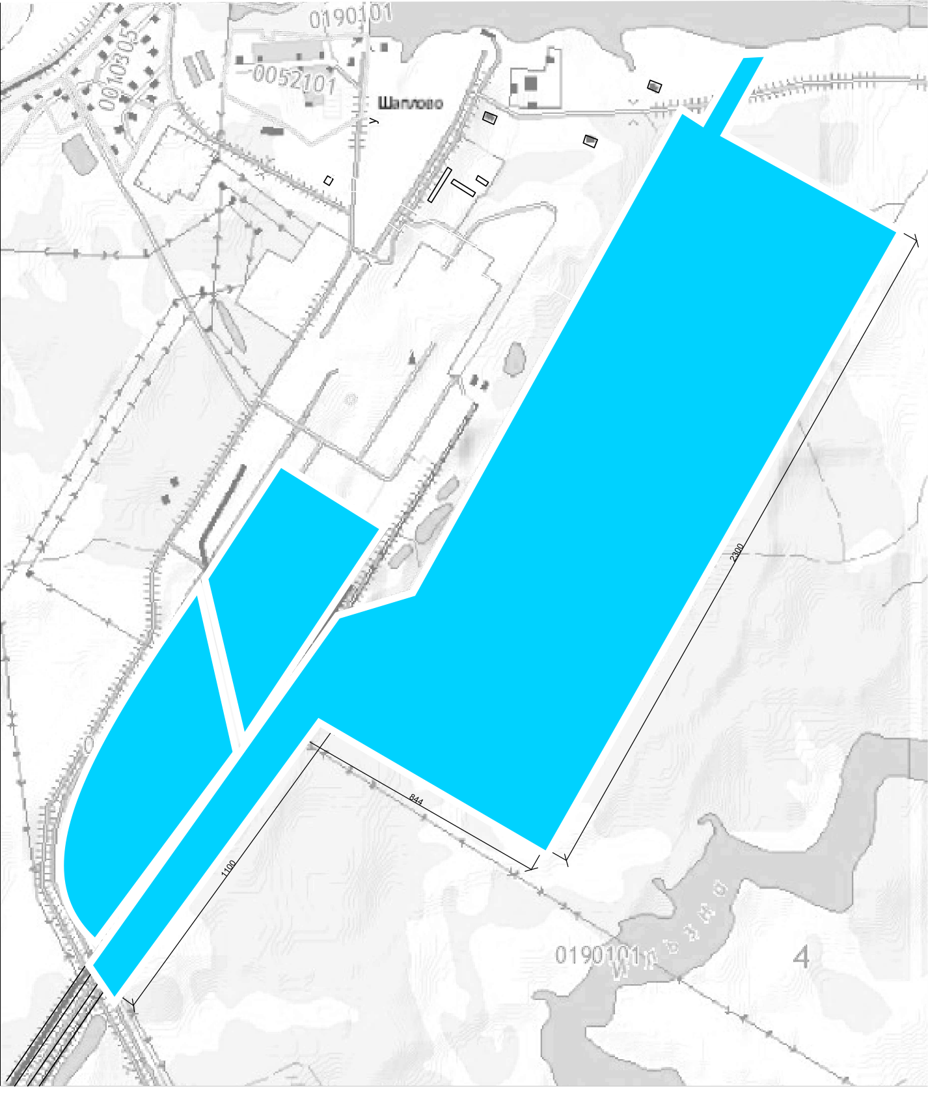
MOGLINO SEZ TERRITORY AND DEVELOPMENT PROSPECT
TERRITORY OF PROSPECTIVE DEVELOPMENT
MOGLINO SEZ – 3
Moglino SEZ – 1 territory
215 ha
Territory of prospective development
industrial and technology park 100 ha
Territory of prospective development
Moglino SEZ - 3
Pskov HEPP
200 ha
Territory of prospective development
Multimodal
«dry port»
25 ha
Titan-Polymer
29 hA
Moglino SEZ – 2 territory
29 ha

Slide 12
+7 8112 33 33 33
info@moglinosez.ru
180502, Pskov region, Pskov district, Moglino village , SEZ PPT Moglino, h.18
www.moglino.com
www.facebook.com/moglinosez
vk.com/moglino_sez
www.instagram.com/sezmoglino/
Thank you
for your attention!
12

