Slide 1
INFRASTRUCTURE AND TOOLS
FOR FOREIGN INVESTMENTS IN INDUSTRIAL SECTOR
Go-To-Market strategy in Russia Step-by-Step
Denis ZHURAVKIY
2020

Slide 4
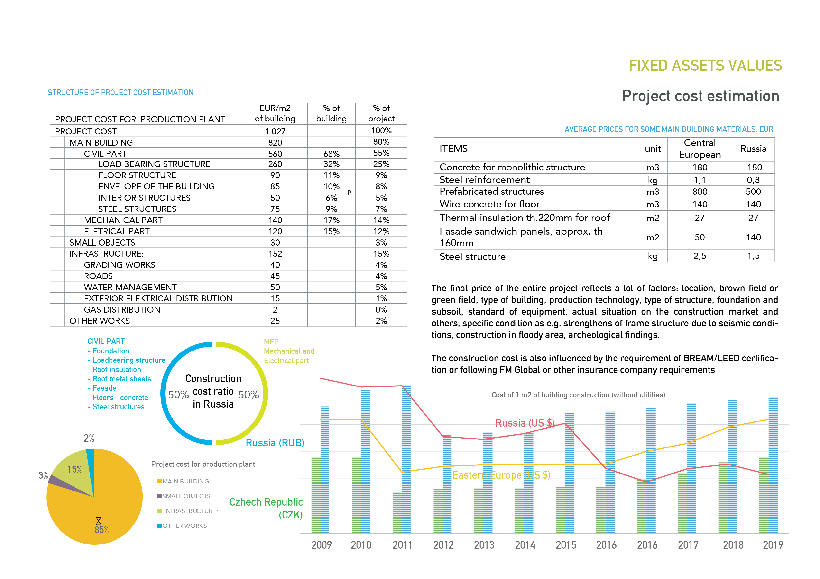

Slide 6
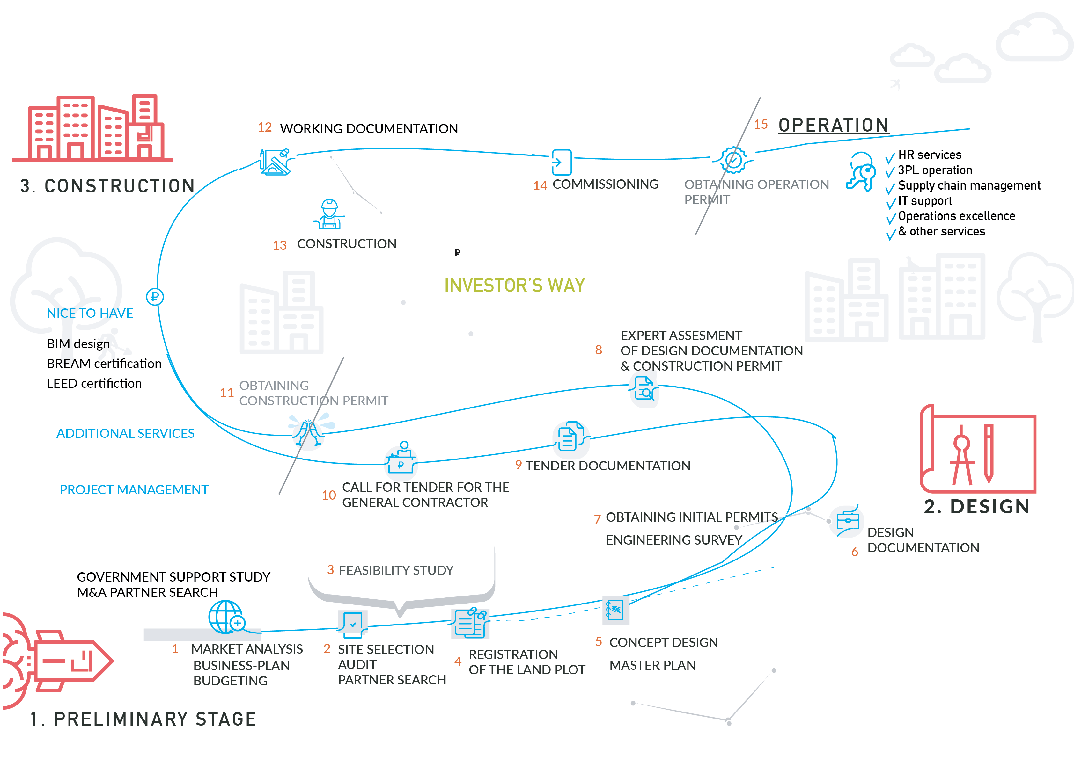

Slide 9
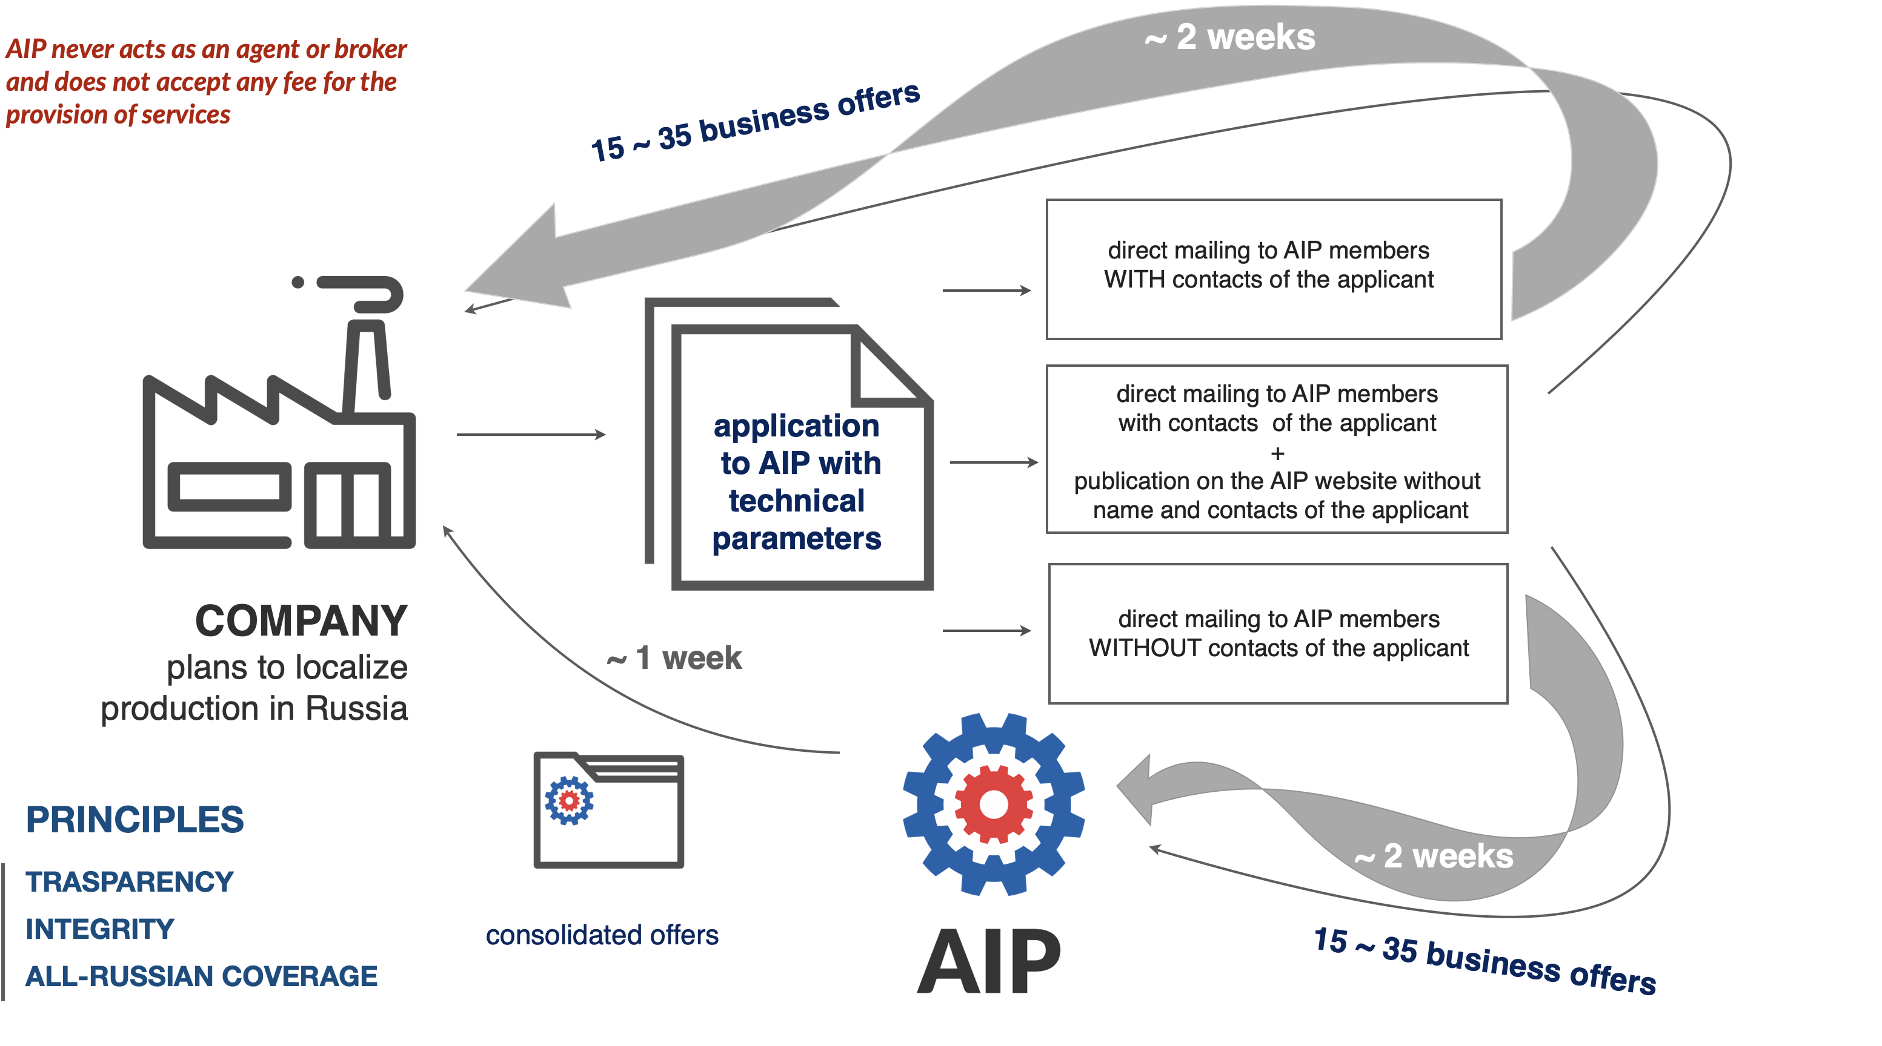
HOW TO CHOOSE AN INDUSTRIAL SITE IN RUSSIA?

Slide 10
HOW TO BUILD A PLANT IN RUSSIA?

